Slide 1
DEPARTMENT OF COMPUTER SCIENCE AND ENGINEERING
CANDY CRUSH
TEAM 2
SECOND REVIEW
BY
DHARUN RAJ R (22CS021)
Guided by
Mrs. C.NAVAMANI M.E.,

Slide 2
SYNOPSIS
WORKING
SNAPSHOTS
CODE MODULE
CONCLUDE
FUTURE SCOPE

Slide 3
WORKING
The provided Java code defines a simple Candy Crush game using the Swing graphical user interface. The game features a grid of candies represented by buttons, and players can swap candies to create matches and earn points. The GUI elements include a JFrame, JPanels, JTextFields, and JLabels for score and moves. The game logic, implemented in the Action class, checks for candy matches and updates the grid accordingly. The check method recursively identifies and replaces matched candies, while the down method is designed to move candies down after matches. The game tracks the player's score and remaining moves, displaying a dialog when moves run out. Although some aspects of the code are incomplete or unused, it provides a functional foundation for a basic Candy Crush game in Java

Slide 4
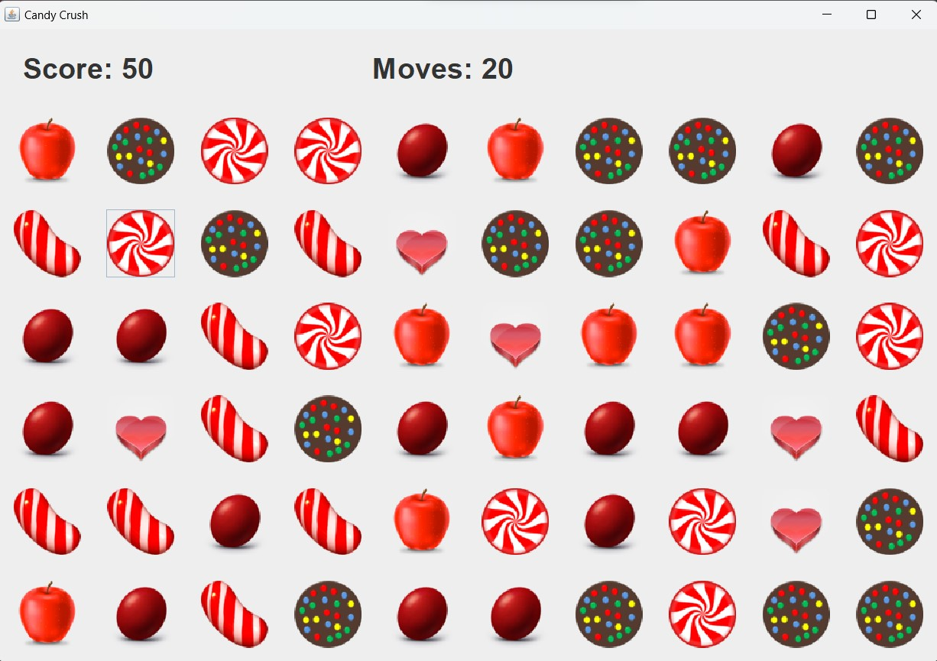
After running the code the game start’s and ready to play . The score be 50 and the moves limits is 20 at being.

Slide 5
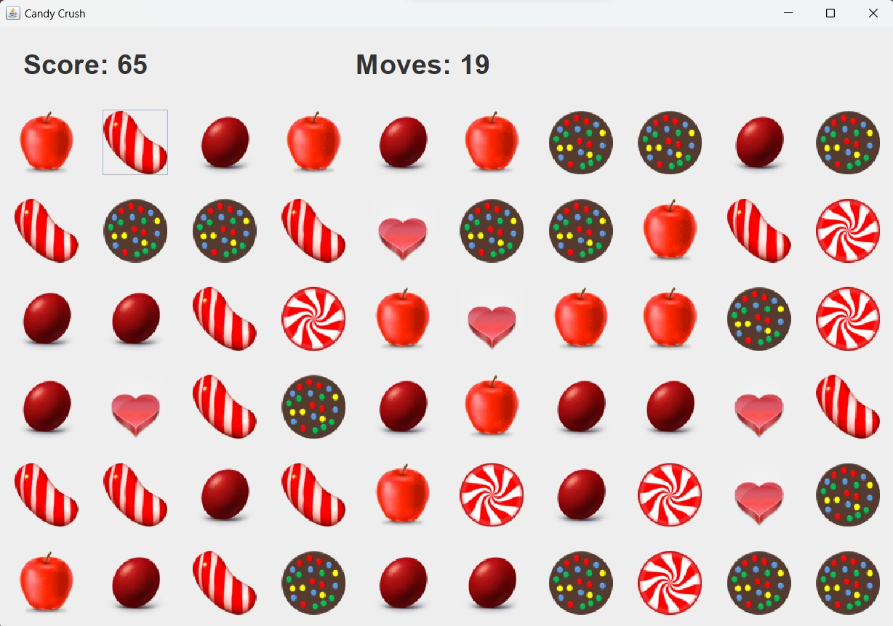
After making a move. Score update and number of move decrease’s

Slide 6
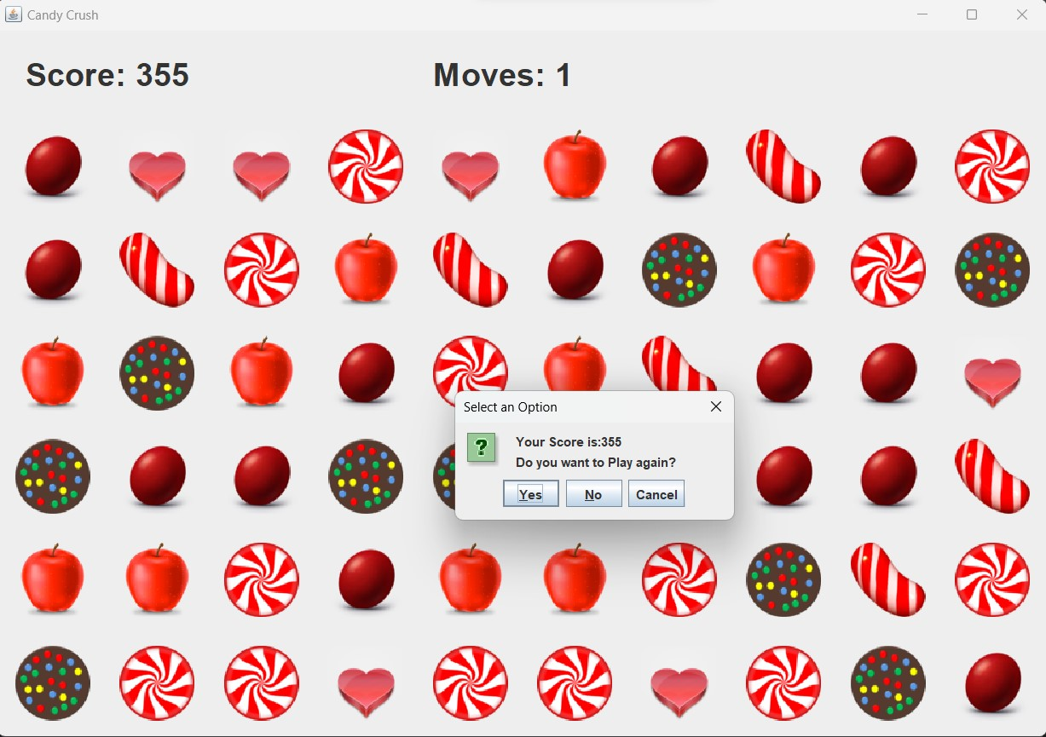
After the move limits reached 1 the game end and the dialog box display’s as show in above Fg:3

Slide 7
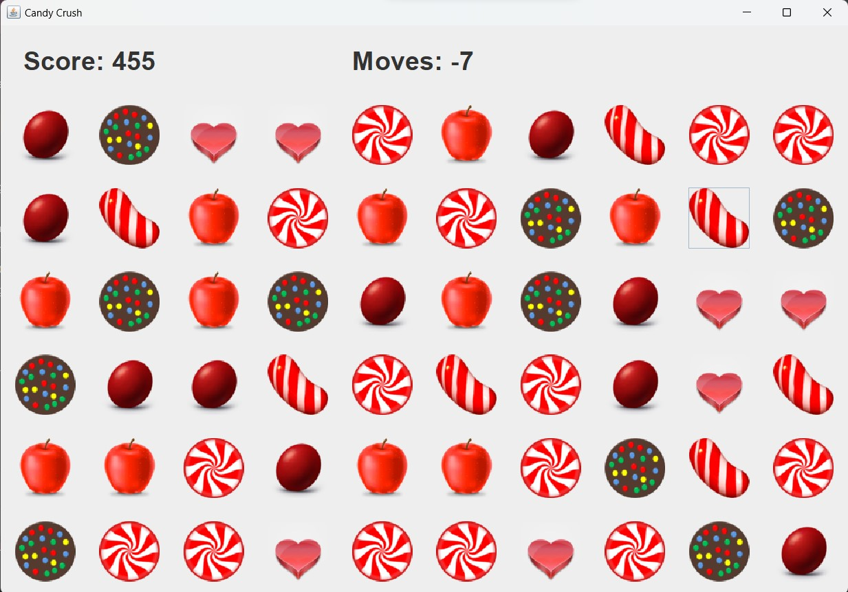
After clicking Cancle button then the move’s go in negative and score updates and game continues

Slide 8
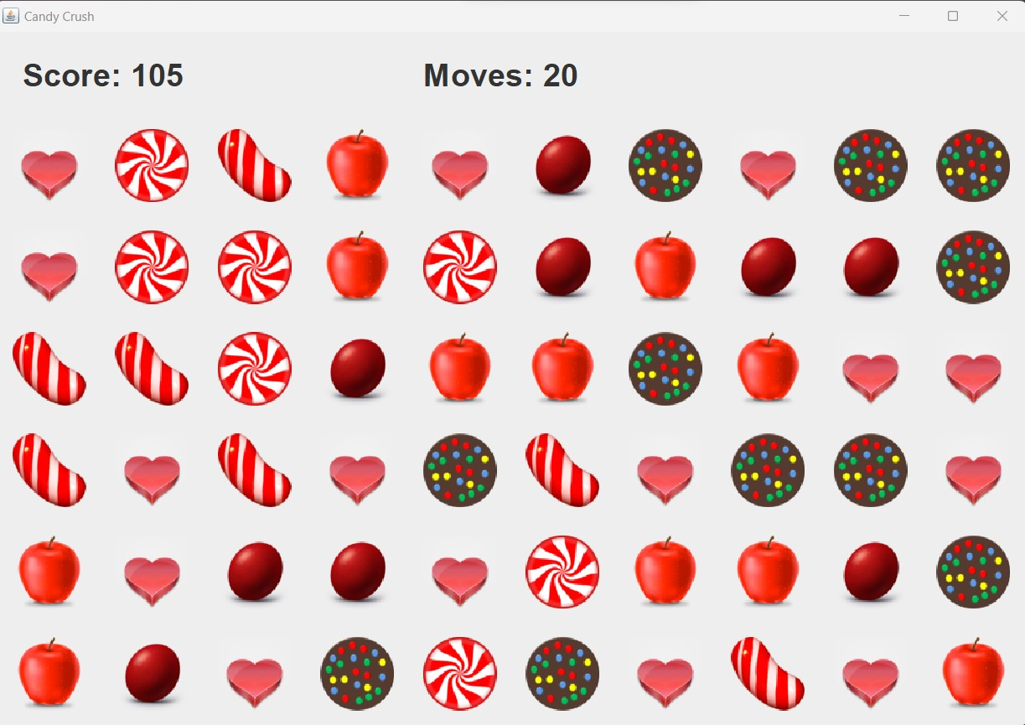
The game restare’s and player can paly farther.
If we press the No button then it exit the game.

Slide 9
If we press the No button then it exit the game.

Slide 10
CODE MODULE
import javax.swing.*;
import java.awt.*;
import java.awt.event.ActionEvent;
import java.awt.event.ActionListener;
import java.net.URL;
import java.util.Random;

Slide 11
CONCLUTION
the provided Java code lays the groundwork for a basic Candy Crush game using the Swing GUI framework. While functional, there is significant potential for future enhancements, including visual improvements, gameplay features such as power-ups and multiplayer modes, and optimizations to the user interface and game logic. The code offers a starting point for further development, and with additional refinements, it could evolve into a more polished and engaging gaming experience, aligning with contemporary standards and player expectations for interactive and entertaining applications.

Slide 12
FUTURE SCOPE
User Interface Enhancement:
Improve the visual design and layout for a more appealing user interface.
Add animations for candy swapping and matching to enhance the gaming experience.
Level Design:
Implement a level system with progressively increasing difficulty.
Introduce different challenges and goals for each level.
Power-ups and Special Candies:
Introduce special candies or power-ups with unique abilities.
Implement special effects or animations for power-up activations.
Sound Effects and Music:
Incorporate sound effects for candy matching, swapping, and other in-game events.
Add background music to enhance the overall gaming atmosphere.
High Score Tracking:
Implement a high score system to track and display the highest scores achieved by players.
Store high scores locally or remotely for competition among players.
Multiplayer Mode:
Implement a multiplayer mode, allowing players to compete or collaborate in real-time.
Introduce social features for sharing scores or challenging friends.

Slide 13


